Slide 1
Candy Power Ranking
Farzad Radmehr

Slide 2
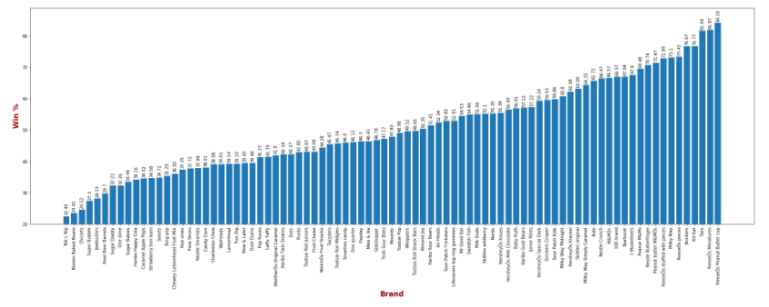
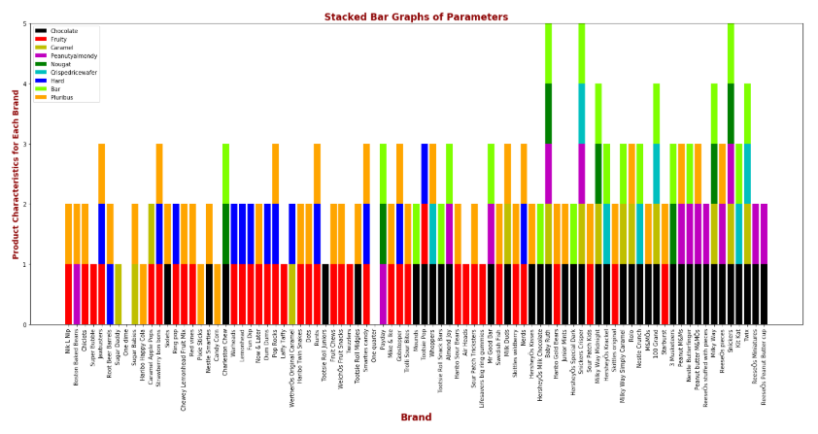
1) Looking at Most and Least Successful Businesses

Slide 3
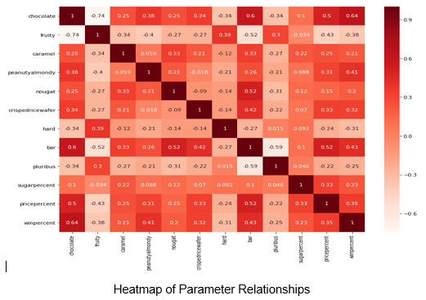
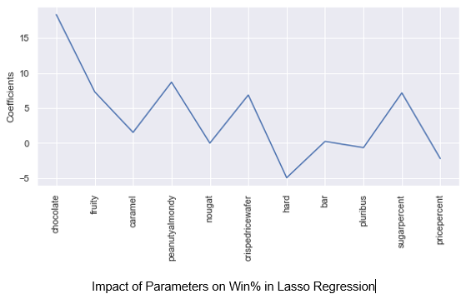
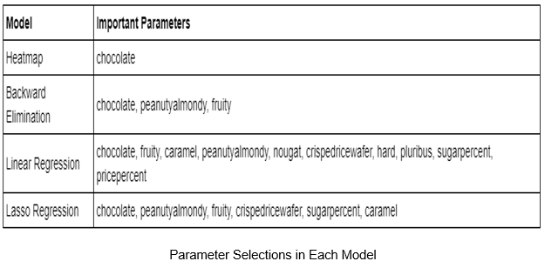
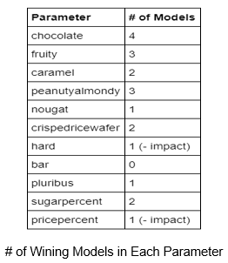
2) Modeling-Parameter Selection
Recommendation
Below product characteristics drive more customers:
Chocolate
Peanutyalmondy
Fruity
Crispedricewafer
Caramel
Add above gradients to increase Sugar % and have less Price %.

